Slide 1

Deep Learning model for Stock Price Prediction
AADITYA PRAKAASH J - (22L201)

Slide 2

Problem Statement
To develop a deep learning model that accurately predicts stock closing prices by analyzing historical data and technical indicators, overcoming market volatility and noise to outperform traditional forecasting methods.

Slide 3

Methodology

Slide 4



Data Collection & Feature Engineering
Data Collection
Feature Engineering
Data Preprocessing
We fetch historical stock price data from Yahoo Finance, a reliable source for financial data, ensuring a broad and up-to-date dataset for analysis.
We calculate technical indicators such as moving averages, RSI, MACD, ATR, Bollinger Bands, and Stochastic Oscillator to provide diverse inputs for the model.
We apply log transformation, scaling, and time-series windowing to ensure data is in the optimal format for training the deep learning model.

Slide 5

MODEL ARCHITECTURE
Dense Layer ( 50 units, ReLu activation) – Processes extracted features before final output.
Dense Layer (1 unit ,Linear activation) - Predicts the stock price.
The Adam optimizer and Mean Squared Error (MSE) loss function are used.

Slide 6
Feature Engineering
Technical Indicators
Simple Moving Averages (SMA): 20 and 50-day SMAs to identify trends.
Exponential Moving Average (EMA): 20-day EMA to give more weight to recent prices.
Relative Strength Index (RSI): Measures the magnitude of recent price changes to evaluate overbought or oversold conditions in the price of a stock or other asset.
Moving Average Convergence Divergence (MACD): MACD and its signal line to identify momentum.
Average True Range (ATR): Measures market volatility.
Volume Moving Average (Volume_MA): Average volume over a period.
Bollinger Bands: Upper and Lower bands to gauge price volatility.
Stochastic Oscillator (%K): A momentum indicator comparing a particular closing price of a security to a range of its prices over a certain period of time
Lagged Returns: 1-day return to capture short-term price movements.

Slide 7
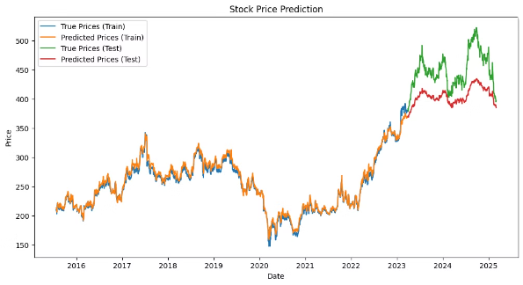
ITC.NS
Predicted stock price for the 28.03.2025 day: 395.44
Actual stock price for the 28.03.2025 day : 409.75
Training & Result Analysis
1.96%
9.14%
Train MAPE
Test MAPE
Demonstrates the model's high accuracy on training data.
Indicates reasonable performance on unseen test data.

Slide 8



Conclusion & Future Works
Conclusions
The Model captures overall trends but struggles with fluctuations unexpectedly. Performance improves with additional technical indicators. Predictions are close to real stock price movements.
Future Work
Enhance predictions by incorporating external factors like news sentiment and macroeconomic indicators. Integrate real-time updates.

